Slide 1

MCA Consulting Excellence Declaration 2026
Your Delivery Technology Consultancy

Slide 2




A message from our COO
Now in our second year as members of the Management Consultancies Association (MCA), our involvement reflects a growing maturity in our contribution to the consulting profession and a continued commitment to high standards of delivery, integrity, and impact.
We were proud to be named a finalist in the MCA Awards 2025, recognised in the Project Category for Social Value for our work with the European Association for Cardio‑Thoracic Surgery (EACTS).
Building on this momentum, we have recently submitted an MCA Award for Technology Transformation this year, recognising our work with Bupa, reflecting our continued focus on delivering technology‑led change with measurable, real‑world impact.
As our engagement with the MCA deepens, we remain focused on sharing best practices, learning from the wider consulting community, and delivering meaningful, outcome‑driven work that creates lasting value for our clients and society.
Jon Bance
Chief Operations Officer

Slide 3
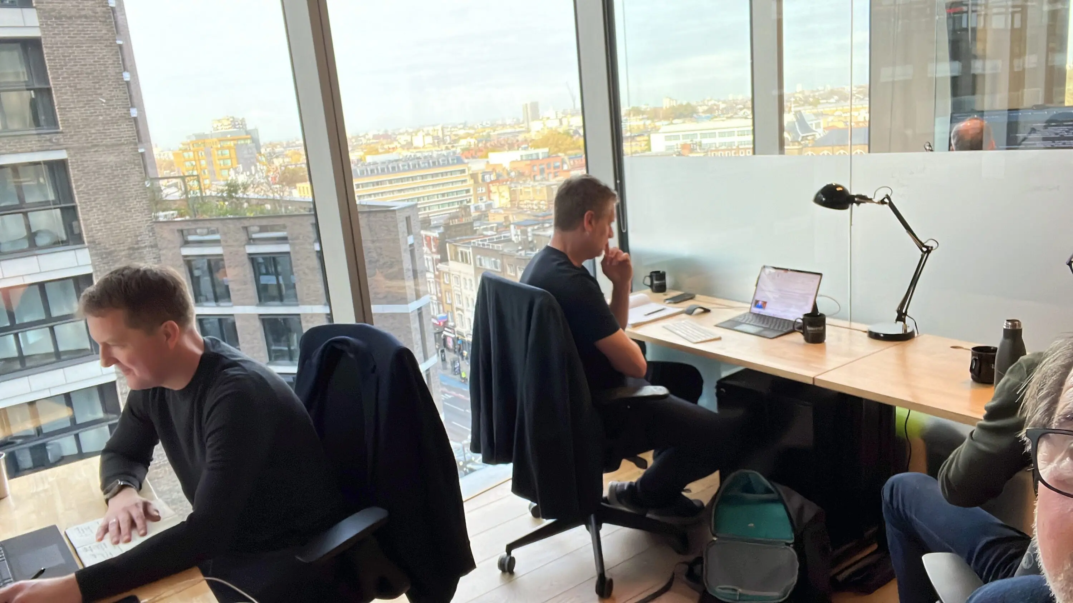

Real people.
Real experience.
Real results.

Slide 4
Our client-first commitment has built enduring, trusted relationships with our clients.
Real world experience - our team of practitioners all have industry experience
Proudly independent - we provide unbiased, client-centric advice that places our clients interests at the forefront
Ceaseless dedication - we consistently go beyond expectations to deliver measurable client outcomes
Delivery specialists - a blend of thinking and doing; a pragmatic team focused on driving incremental business benefit at every step
World class proven expertise - our team excels in the digital technology landscape staying ahead of the curve
Trusted consultants - our team brings empathy and emotional intelligence to create positive working environments and genuine collaboration
Cost effective – a flexible and fractional human-led capability model
True, value-added partnership approach - leveraging industry experience and technology expertise

Slide 5








We are the alternative to the Big 4.
We are technology consultants with a difference, offering independent advice with your best interests at heart, combining expertise, experience and commercial savvy to deliver your desired business outcomes.
Accolades
We’re proud to be named one of the UK’s Leading Management Consultants 2026 by the Financial Times for the sixth year running, recognising our expertise across key sectors.
Proud members of the MCA, and a finalist in the MCA Awards 2025 Social Value category for our work with EACTS, reflecting our commitment to the highest standards of ethical, professional consulting.
Cyber Essentials Certified, underscoring our commitment to robust cyber security and protecting our systems, data, and stakeholders.
Proud to be a SafeRec Plus member, providing real‑time payroll monitoring, RTI checks and ongoing supply‑chain oversight for greater transparency across our umbrella partners.
FSQS registered, giving financial services clients confidence that robust supplier due diligence is in place.

Slide 6
Our industry pedigree
With 25 years of experience, our team at Leading Resolutions bring deep industry expertise to help our clients navigate and thrive during phases of growth and business change
We understand our clients’ business and the specific pain points, challenges and the barriers they face.
We bring extensive experience in unlocking business value through technology, helping organisations surface critical data, improve decision-making, and drive measurable outcomes.
We can advise on the art of the possible based on our knowledge of how other organisations are exploiting digital technologies to deliver the most efficient business processes.

Slide 7
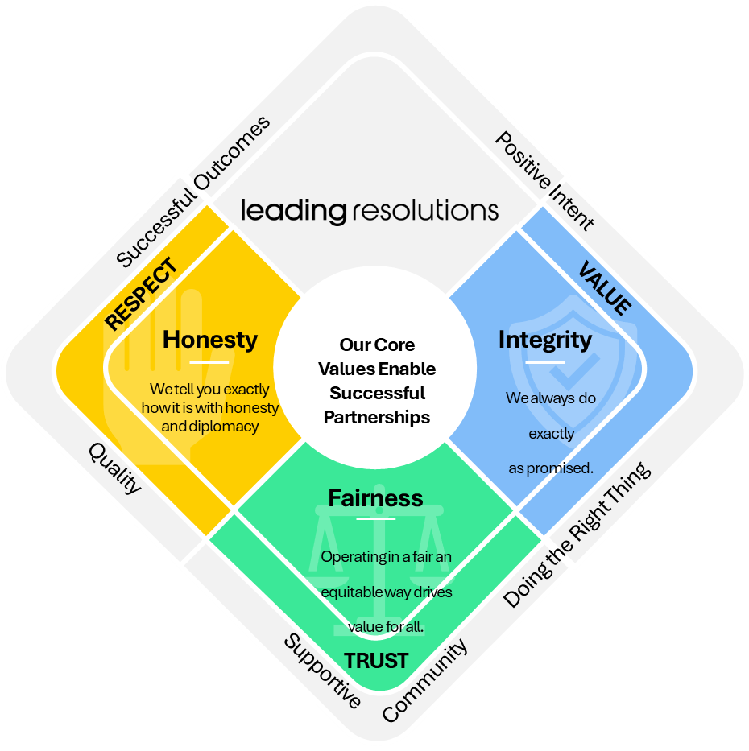
We pride ourselves in living and breathing our values of honesty, integrity and fairness
Our behaviours are designed to honour our culture, and we actively recruit against them.
Starting with positive intent to drive the best outcome for client, LR and consultant leads to us always doing the right thing. This creates a supportive community, focussed on quality and successful outcomes, which breeds positive intent.

Slide 8
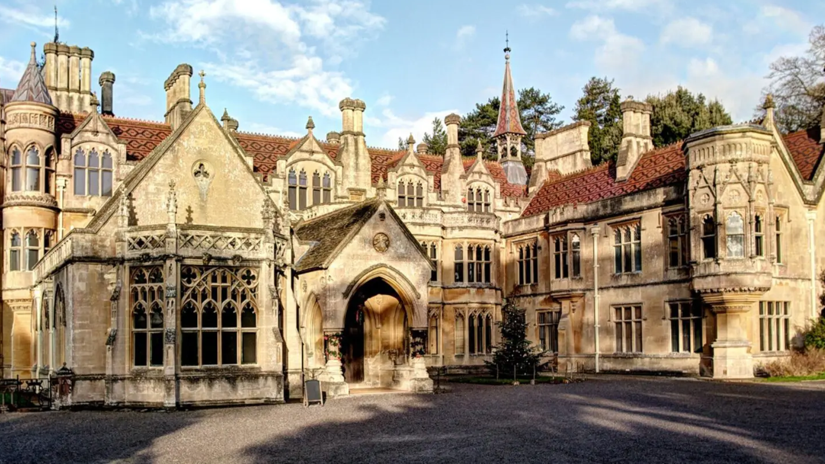
“We share a set of values with Leading Resolutions that includes honesty, openness and integrity. We wanted to work with like-minded people and that’s exactly what was delivered.”​
Sarah Flanagan
National Trust, CIO

Slide 9


Consulting Excellence Principles
9
9

Slide 10





Committed to adopting the fourteen Principles of Consulting Excellence
Ethical Behaviour
Client Service and Value
Professional Development
Commitment to Diversity and Inclusion
Commitment to Sustainability
Consulting Excellence firms work with clients, partners, employees and other stakeholders in an ethical way. This means:
We are responsible and good citizens.
We conduct our business ethically.
We foster an ethical culture.
Consulting Excellence firms promote the highest standards of client service and value. This means:
We provide excellent consulting services which deliver the outcomes clients seek and need.
We are transparent with clients and respond to their concerns.
We always strive to improve the value we can deliver to our clients.
Consulting Excellence firms develop the capabilities of their consultants, provide career development opportunities and support the welfare of all their employees. This means:
We undertake training and professional development planning each year.
We promote strong core consulting capabilities and specialisms in our consultants and teams.
We support our employees’ career progression, professional development and welfare.
We support the adoption of the Chartered Management Consultant (ChMC) Accreditation across the industry and champion its values.
Consulting Excellence firms are committed to diversity and inclusion within their workplace and workforce.
This means: We respect and embrace diversity and inclusion and understand the importance and positive benefit of people from different backgrounds working for our companies and our clients.
We recruit and retain people from a diverse talent pool and strive to build cultures where difference is valued, respected and celebrated at all levels. Furthermore, we are committed to developing diverse future leaders and ensuring their progression in the industry.
We support industry efforts to improve progress on diversity and inclusion, implementing best practice and monitoring the diversity of the consultancy sector workforce over time. This includes encouraging the collection of data to assess the effectiveness of D&I policies and participating in the MCA annual report.
Consulting Excellence firms are committed to sustainable development within their organisations and their work with clients. This means:
We commit to ensuring that our firms operate in an increasingly sustainable way and strive to ensure that sustainability is considered by our clients in our work with them.

Slide 11
Ethical behaviour
Leading Resolutions expects all individuals working with the company to uphold the highest standards of ethical conduct. Clear policies guide behaviour, emphasising integrity, honesty, and professionalism, with misconduct potentially leading to disciplinary action to protect the company’s reputation.
Transparency about potential conflicts of interest is required, with disclosure and written permission needed before engaging in outside work. All gifts or hospitality from clients or suppliers must be reported, accepting only small tokens or low-value items, while refusing anything of significant value. The company enforces a zero-tolerance policy on bribery and corruption, requiring the reporting of any suspicious activity. Company property must be used responsibly and only for business purposes, with misuse considered serious misconduct.
Confidentiality is essential, and sensitive information must be protected during and after association with the company, shared only when authorised. Social media and public conduct should reflect the company’s values, avoiding content that could harm its reputation. Individuals are encouraged to report unethical or illegal behaviour confidentially and are protected from retaliation.
Leading Resolutions is committed to fostering an ethical culture where integrity, transparency, and respect guide every decision and action, ensuring a positive and trustworthy environment for all stakeholders.

Slide 12
Client service and value
World Class Expertise: Our independent team of digital technology experts blends advanced business strategies with cutting- edge solutions to delight clients. With over 200 trusted consultants, we offer top-notch technical consultancy.
Client-First Culture: We are committed to client success with strong integrity and always in your best interests. Our client retention rate reflects this. 'Ceaseless Dedication' is our core practice, driving your business forward with advanced strategies and solutions. We stay ahead of the technological curve, ensuring your business sets the pace. Expect a partnership tirelessly invested in your success.
Continuous Improvement: We work smart, deliver fast, and create sustainable solutions, always looking for innovative ways to drive value for clients. Our established feedback loop captures insights on resource performance, allowing us to adapt our services as required.
Proudly Independent: Our independence is your strategic advantage. We provide unbiased, client-centric advice, evaluating all technological options objectively to ensure the best fit for your business needs and goals.

Slide 13
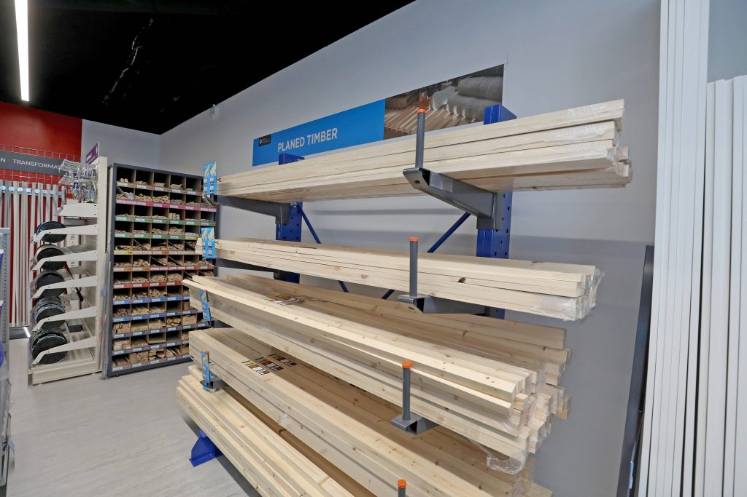
“Upgrading our ERP wasn’t just a technical project; it was a strategic investment in our future. Leading Resolutions brought the right blend of structure, empathy, and delivery focus to guide us through it.”
Richard Cross
IT Director, Leyland

Slide 14
Professional development
Empowering our people: development, career growth and wellbeing
Employee Success Program
The Employee Success Program is a performance framework that supports continuous growth and aligns individual goals with company objectives.
It includes annual goal setting, regular check-ins, feedback, and year-end reviews, along with career development through training, mentorship, and long-term growth planning.
Our success stems from nurturing talent and fostering a supportive, growth-oriented environment. We invest in our team through continuous learning, mentorship, and hands-on experience, ensuring exceptional value for our clients.
Professional development is central to our culture, with clear paths, regular feedback, and diverse opportunities empowering individuals to shape their journeys.
We actively encourage collaboration and knowledge sharing with the team benefiting from expert guidance, proprietary IP and tools, tech talks, business updates, Gartner insights, and our innovation platform
We prioritise employee wellbeing through mental health support, flexible working arrangements, inclusive policies, and wellness resources, fostering a culture where people thrive.

Slide 15

“The business update webinars are definitely mutually beneficial; I haven’t come across another company that has sharing sessions for both employees and non employees.”
Principal Consultant
Leading Resolutions

Slide 16
Commitment to diversity and inclusion
We are committed to equal opportunities in our employment practices, valuing a diverse workforce and aiming to prevent unlawful discrimination. Our goal is to ensure equal opportunities and protect everyone's rights.
We ensure fairness by respecting diverse needs, providing equal opportunities, and treating everyone with dignity and respect, without discrimination based on age, disability, sex, gender reassignment, pregnancy, maternity, race, sexual orientation, religion, belief, or marital/civil partnership status.
All employees must support equal opportunities and avoid unlawful discrimination. Acts of discrimination, harassment, bullying, or victimisation are disciplinary offences. Employees can use our grievance procedure to report unlawful discrimination.
We support individuals with protected characteristics to ensure equity and fairness, including making reasonable adjustments for disabilities and maintaining a positive, harassment-free environment.
We regularly update our diversity and inclusion policy to reflect legal changes and review the ethnic, gender, and disability composition of our workforce and applicants to ensure effectiveness.
We are committed to a harmonious environment where everyone is treated with respect and dignity, regardless of personal factors or qualities.

Slide 17
Commitment to sustainability: deeply integrated into our ESG activities
Environmental
Social
Governance
Electric Car Scheme available to all employees. - Since our last MCA submission, our Electric Car Scheme has saved 11 tonnes of CO₂ launch saving 9.22 tonnes of CO2 (the equivalent of circa 5,500 trees)
Cycle to Work Scheme in place
Planted over 1,000 locally sourced trees on a global programme
Reduced travel by encouraging hybrid working for all
Reduction in fuel bills to heat the office by having specific on-site days
Water station to reduce the need for bottled water
Responsible procurement and recycling of electronic waste and equipment
Inclusion Committee established, driving diversity and inclusion agenda across the business
Over £4k donated to charity in the last 3 years
£20k pro-bono work provided to local hospice and special needs school
Accredited Living Wage Employer with the Living Wage Foundation
Employee wellbeing “breakfast and heat” scheme
Specific on-site days to retain social connections
Access to Vitality Health for all employees, supporting physical and mental wellbeing
Cyber Essentials accredited
GDPR compliant
Data Committee driving compliance within our business and our clients
IR35 compliant
Organisational succession planning with career objectives, training and development plans in place
SFIA framework alignment to ensure correct placement and standardisation of practices
‘Ethical use of AI’ training via Oxford University Saïd Business School

Slide 18


Thank you
Jon Bance
Chief Operations Officer
Jon.bance@leadingresolutions.com
Krista Linnel
Head of Marketing
krista.linnel@leadingresolutions.com
Confidentiality and Copyright
We, Leading Resolutions Limited, own the copyright to this document. It contains proprietary information that belongs to us. It is subject to the confidentiality provisions we have made with you. Therefore, it must not be reproduced or disclosed to a third party unless we have given you our written consent first.
We are submitting the information contained in this document on the understanding that only you and your staff will use it. If you employ external consultants, you must ensure that you restrict their use of this information to work related to your business.
Your Delivery Technology Consultancy
leadingresolutions.com

