Slide 1
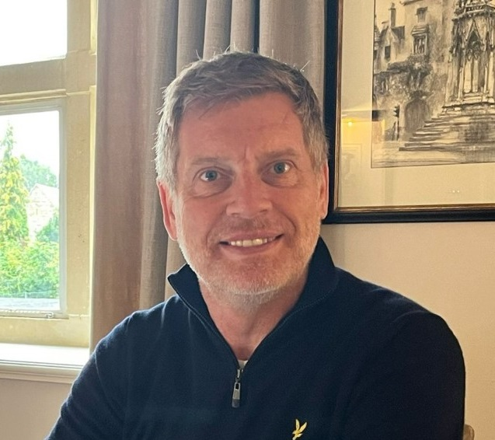
Environmental, social and governance issues are a central tenet of our business strategy
We want to ensure that our business considers its wider influence on our planet, people, and communities.
We seek positive impact in all that we do, focusing on generating social value, not just economic. We celebrate diversity and encourage people from all sections of society to build a career with us.
Our Ambassador Awards campaign celebrates individual achievement, enabling participants to select a charity for monetary or pro-bono support each month.
We are proud of our company, our culture and our team, all of which holds, in its simplest form, the basic principle of “doing the right thing by all stakeholders” at its core.
“Our philosophy is to make Environmental, Social and Governance part of our core strategy; not just for our own business but influencing our client strategies too.”
Jon Bance, Chief Operating Officer

Slide 2
We are fully committed to ESG with a number of initiatives in place.
ENVIRONMENTAL
Electric Car Scheme available to all employees - since launch saving 9.22 tonnes of CO2 (the equivalent of 4,610 trees)
Cycle to Work Scheme in place since 2019
Planted over 1,000 locally sourced trees on a global programme
Reduced travel by encouraging hybrid working for all
Reduction in fuel bills to heat the office by having specific on-site days
Water station to reduce the need for bottled water
SOCIAL
Inclusion Committee established, driving diversity and inclusion agenda across the business
Over £4k donated to charity in the last 3 years
£20k pro-bono work provided to local hospice and special needs school
Accredited Living Wage Employer with the Living Wage Foundation
Employee wellbeing “breakfast and heat” scheme
Specific on-site days to retain social connections
Access to Vitality Health for all employees, providing physical and mental wellbeing support
GOVERNANCE
Cyber Essentials accredited
GDPR compliant
Data Committee driving compliance within our business and our clients
IR35 compliant
Organisational succession planning with career objectives, training and development plans in place
SFIA framework alignment to ensure correct placement and standardisation of practices
‘Ethical use of AI’ training via Oxford University Saïd Business School

Slide 3
We will continue to evolve our approach to ESG with more initiatives underway or planned for 2025
ENVIRONMENTAL
Reducing office carbon emissions (solar, renewables)
Further LEO platform challenges for net zero
Further waste management and recycling improvements, including electronic waste
Plastic removal scheme
Creation of environmental champions
Supporting biodiversity and conservation projects
SOCIAL
Intern programme for local educational bodies
Reviewing our employment practices and Employee Handbook to enhance our commitment to Equity, Diversity & Inclusion
Community Social Responsibility – charity volunteer days
Further LEO platform challenges for social inclusion impacts
LGBTQ+ / Pride participation
Mental health first aiders
GOVERNANCE
AI Ethical Design
Progression towards B Corp status
Integrated systems to provide ‘one version of the truth’, leading to transparent reporting
ESG auditing and reporting
Ongoing ESG staff training programme being developed, with an emphasis on ESG decision making
Collaboration with our suppliers to support them with ESG initiatives

